Slide 1
TURKEY’S CENTRAL ROLE FOR ENERGY TRADING
17th. Annual CIS & Turkey Oil and Gas Transportation Congress
11-12th. November 2015 – Istanbul
Erdoğan Arkış
Gas Group Leader & Member of the Board

Slide 2
Member Companies
AKENERJİ
AKFEL
AKSA
ALADDIN MIDDLE EAST
ANGORAGAZ
ATTİLA DOĞAN İNŞAAT
AVRASYA GAZ
AYGAZ
BATI HATTI GAZ
BM HOLDİNG
BORDRILL SONDAJ
BOSPHORUSGAZ
BP
CHEVRON
COUGAR DRILLING
ÇALIK ENERJİ
DEMİRÖREN EGL
DOĞAL ENERJİ
DOĞAN ENERJİ
EDİSON
EGEGAZ
ENERCO ENERJİ
ENERJİSA
ENERYA
ERDGAZ
EWE ENERJİ
EXXONMOBIL
GDF SUEZ
GENEL ENERGY
GLOBAL ENERGY
GÜNEY YILDIZI PETROL
HATTUŞA ENERJİ
HİPOT ENERJİ
IBS RESEARCH
KİBAR ENERJİ
MARSA ENERGY
NATURGAZ
OMV
PALMET ENERJİ
PERENCO
POZİTİF DOĞALGAZ
RWE & TURCAS GE
SCHLUMBERGER
SHELL ENERJİ
SOCAR
STATOIL
TBS PETROL
TEKFEN İNŞAAT
TEMİ
THRACE BASIN
TIWAY
TOTAL
TURCAS
VALEURA ENERGY
VOLT ENERJİ
YENİ ELEKTRİK
ZMB GAZ DEPO
ZORLU ENERJİ

Slide 3
Contribution of PETFORM Members to Turkish Economy (2013)
Total Endorsement : 63.7 billion TL
(5% of GDP)
Total Tax : 4.3 billion TL
Total Employment : 31.500 person

Slide 4
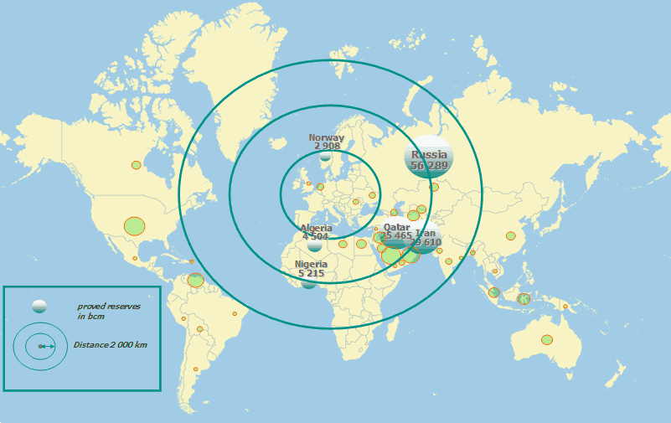
Geographic Distribution of Existing NG Reserves, Except Egypt
Kaynak: GDF SUEZ
Notes:
Burada bir noktanın altını çizmek istiyorum: Türkiye’nin etrafında 2.000 km yarıçapında bir daire çizdiğimiz takdirde, dünya doğalgaz rezervlerinin %83’ünün bu daire içerisinde kaldığını görebiliriz. Bunun da ülkemizin dünya enerji panoramasında ne kadar önemli bir yerde olduğunu gösterdiğine inanıyorum.

Slide 5
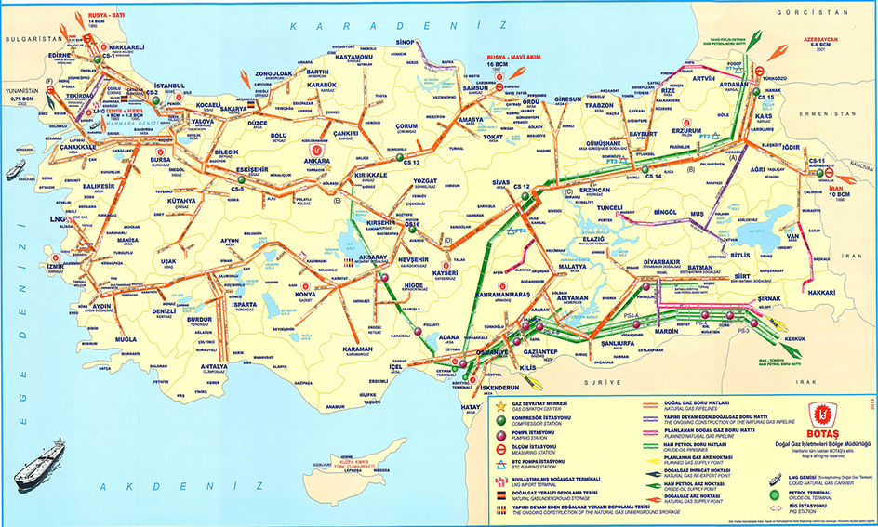
Turkey’s Main Grid of BOTAS

Slide 6
Turkish Market Main Milestones and Current Picture
14 years
2001
Law 4646
2008
1st Phase Private Sector Contracts
2013
2nd Phase Private Sector Contracts
2015
New 4646
(TBA)
3

Slide 7
Turkey’s Natural Gas Imports by Countries (2012 – 2014)
(bcm) | 2012 | 2013 | 2014 | Share in Total (2014)
Russia | 25.406 | 26.491 | 26.975 | 55 %
Iran | 8.190 | 8.215 | 8.932 | 18%
Azerbaijan | 3.806 | 3.354 | 6.074 | 12 %
Algeria (LNG) | 4.156 | 4.076 | 4.179 | 8 %
Nigeria (LNG) | 1.248 | 1.322 | 1.414 | 3 %
Spot LNG | 1.069 | 2.464 | 1.689 | 4%
Total | 45.9 | 45.2 | 49.2
Source: Energy Market Regulatory Authority
Notes:
Geçtiğimiz 3 yılın verilerine ülke bazında dağılıma baktığımızda, %58 payla Rusya’nın en büyük gaz tedarikçimiz olduğunu, onu %18 payla İran’ın takip ettiğini görüyoruz.

Slide 8
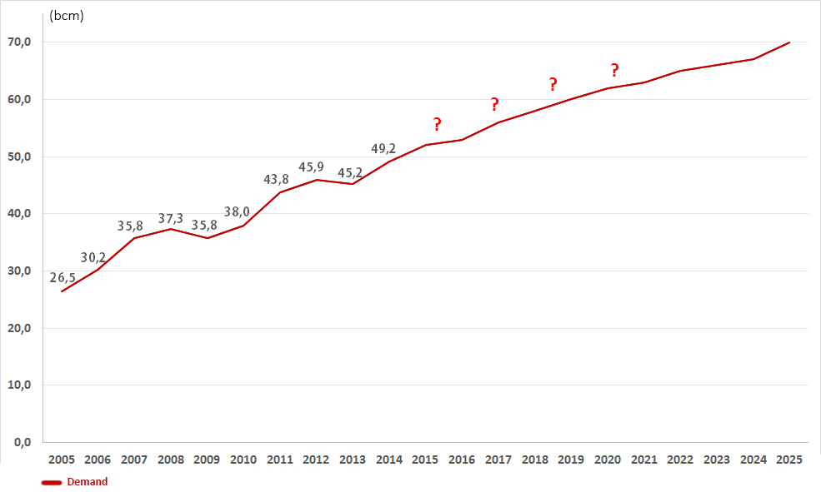
Natural Gas Demand Projection
Source:BP
Notes:
BP

Slide 9
Is a Concern Emerging?
Energy is the basic source of highly qualified daily life in developed countries.
But the recent situation in Europe & Turkey indicates that the demand to NG is not consistently increasing.
Demand and the diversification in the supply of NG sources shall be considered

Slide 10
Results of not being a trading HUB?
Limited diversification of resources,
Becoming more powerful of source country’s in each contrat term bargain
To continue having an important role as transit country in the supply security of consumption countries
Not to provide a competition between gas to gas,
Not having enough opportunity from the chances in the global market
If the country cannot be a trading hub, it can be only a transit hub
22

Slide 11
Switch to Hub Pricing
(2005 – 2013)
Source: ICIS

Slide 12
Trading Hub: Gas Market
Target Model for Turkey
Physical Infrastructure
- Very well developed and maintained physical infrastructure
- No rectrictions and congestions to meet peak demand
- Cross border capacity development with minimum congestion
- New storage and LNG facilities for supporting supply security to seasonal and peak demands
Regulatory Framework
-Policy drafting regulatory body should understand the real Dynamics of the Energy, TPA, Network Code, Independent TSO etc.
- Implementation of policies via EU directives.
- Monitoring of wholesale market integrity, competition (antitrust) and effective consumer interest protection is needed for competition
-Unbundling of transmission and counteraction of incumbets’ vertical dominance
Independent Transmission System Operator
-Appropriate capacity-booking model (entry/exit model, use it or loose it principle)
- Effective balancing mechanism
- Effective nomination processes
- Publicizied imbalance charging structures (not overly punitive)
-Very well integrated storage injection and withdrawal processes to the transmission system
-Transparent tariffs for system entry and exit
Commercial and Market Conditions
-Formation and active promotion of common pricing reference
- Free day ahead and intraday price assessment mechanism - Standart and commonly expected physical contracts - No barrier for new entries
- No destination clauses
- Transparent price-discovery mechanisms / platforms ,functioning forward market
-Good synchronization between balancing, nearby and forward markets
-Stable financial and credit envrironment and mechanisms
Notes:
Physical Infrastructural
Very well-maintained physical network infrastructure is a must without any hesitation.
Congession management should be done efficiently. Network capacity should be optimized and constraints should be removed. We have to develop interconnections with Greece and Bulgaria for facilitating cross-border flows with minimum constraint.
New Storage and LNG facilities for supporting supply security to seasonal and peak demands should be realized.
Regulatory
Policy-drafting regulatory body should understand the real Dynamics of the Energy. Implementation of policies via EU directives and network Access rules such as Network Code for TPA, independent TSO, etc.
Monitoring of wholesale market integrity, competition (antitrust) and effective consumer interest protection is needed for the establishment of the competition. Unbundling of transmission and counteraction to legacy of incumbents’ vertical dominance is the one of the important item of the liberal gas market.
Network Operational
Appropriate capacity-booking model such as Entry/Exit model and use-it-or-loose it principle should be applied. Effective Balancing Mechanism and balancing market is needed. Efficient Nominations processes and systems is one of the prerequisition of the market. Publicized imbalance charging structures (not overly punitive) – preferably market-based can only be established with balancing gas market. Very well-integrated storage injection and withdrawal processes is needed. Transparent tariffs for system entry plus exit and distribution to retail zones is needed.
Market and Commercial
Formation and active promotion of common pricing reference is one of the key element of an Energy hub. Free day-ahead, and intraday price assessment mechanism without any invervention should be needed. Standart and commonly excepted physical contracts are needed. By awaring the long term contracts for captital intensive investments, price linkage should be provided. Destination clauses is an important issue for a workable gas market. Transparent price-discovery mechanisms/platforms, functioning forward market is a must.
Good synchronization between balancing, nearby and forward markets should be established. Stable financial and credit environment and mechanisms (such as clearing house) is needed for counterpart risk management.

Slide 13
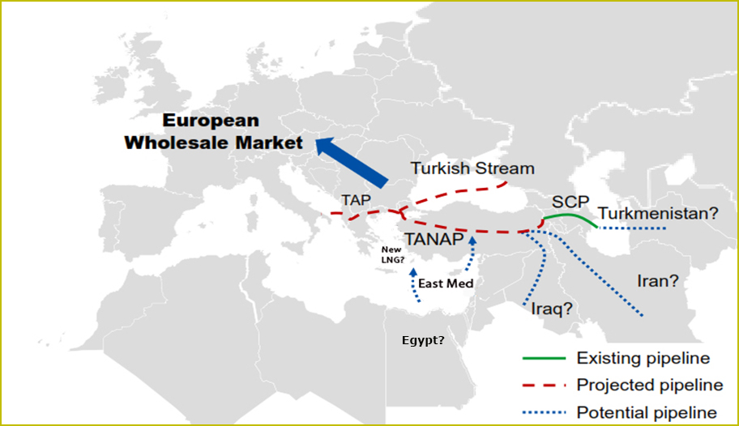
New Supply Opportunities Except New Egypt Reserve
Source: RWE

Slide 14
Requirements for an Organized Market in Turkey
NG shall be included into an autonomous structure of EPIAS process.
Entrance Capacity of main grid is not satisfactory.
Compatibility with international arbitration.
HUB indexed and the Cost Base pricing.
Gas to gas competition. Free Contracting.
The Transmitting Companies shall be independent and transparent.
Underground storing and LNG terminals are needed.
New Law to encourage “the buyer based trading”.
Source: BOTAS & PETFORM

Slide 15
Energy Commission:
Turkey 2015 Report
Regarding energy networks, Turkey has continued its efforts to diversify both sources and routes and has strengthened its role as a gas transit country. Major efforts have been made to move forward the trans-Anatolian pipeline project and construction work was launched in March 2015. In December 2014, Russia announced a new gas transportation project in cooperation with Turkey, to replace the South Stream pipeline project, but its construction is uncertain. A fair and transparent gas transit regime in line with the EU energy acquis is necessary for Turkey to play a major role as a gas transit country to the EU.

Slide 16
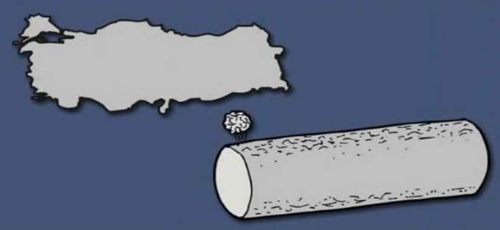
Perception is Reality

Slide 17
THANK YOU...

